Slide 1
Heart Monitor Project
CSCE430102 - Embedded Systems (2020 Spring)
Dr. Mohamed Shalan
Ahmed Abouzaid – 900163141

Slide 2
Project Objectives
Develop an embedded application using the STM32 module and the ECG sensor to collect ECG signal and report it to a PC over USB link for displaying and further analysis. The embedded code accepts the following commands from the connected PC over the serial link:
Set the sampling rate - Collect 1-minute worth of data - Report the heart beat rate (bpm)
The commands must be sent using an application running on the PC. The sent ECG data must be graphed using the same application. If you develop in Python, use pySerial and matplotlib. The application must provide UI elements to select the COM port and baud rate. Also, it must provide UI element to set the sampling rate.

Slide 3
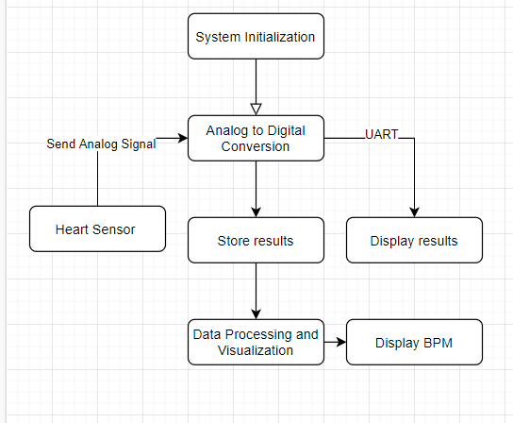
Architecture diagram

Slide 4
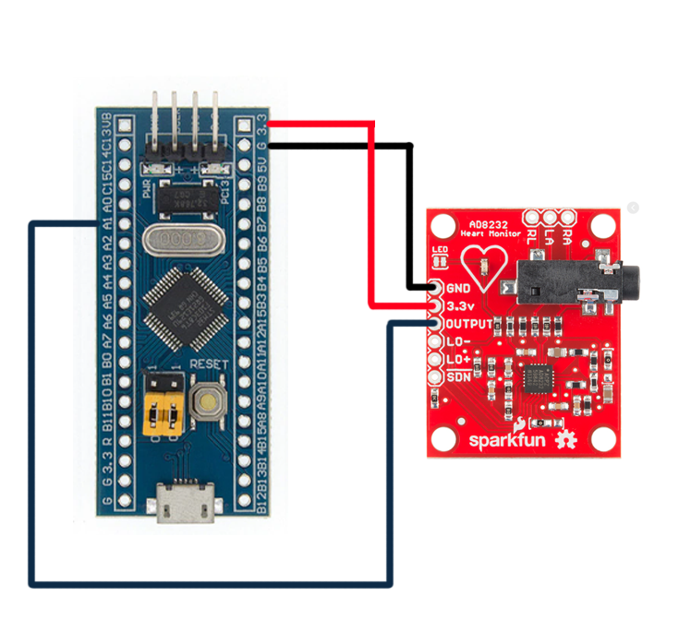
Circuit diagram

Slide 5
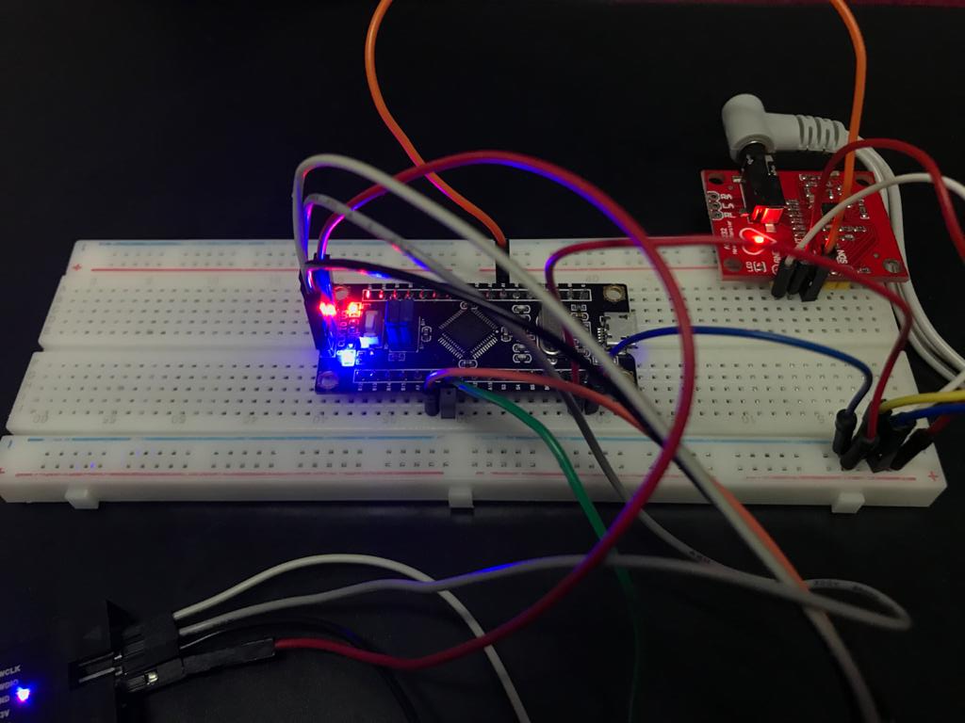
Circuit connections

Slide 6
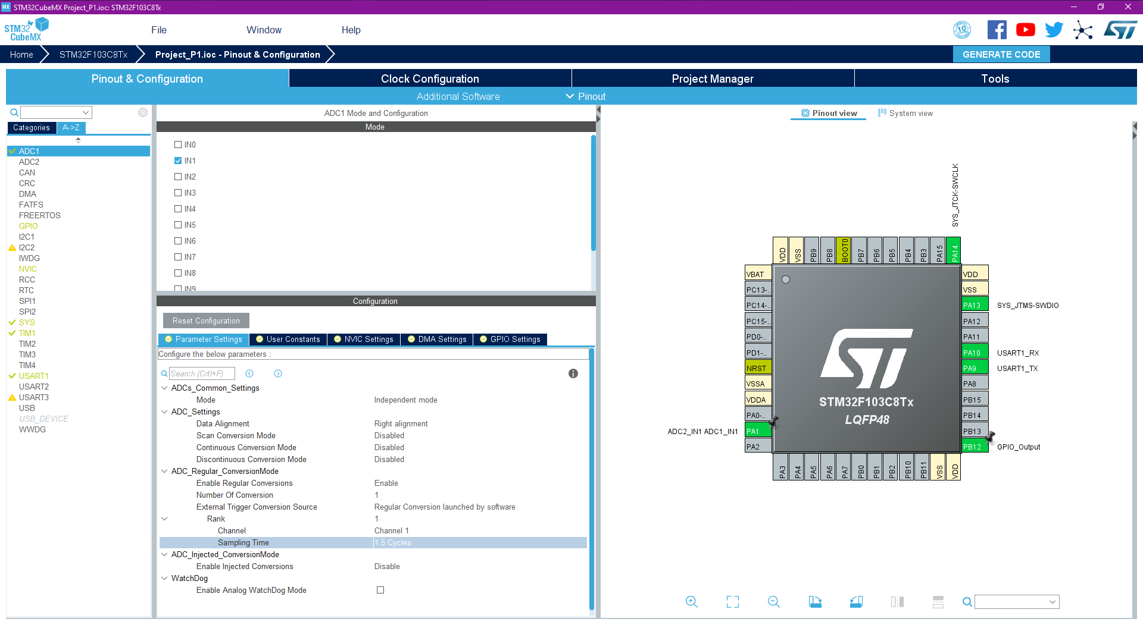
STM32CubeMX configurations

Slide 7
Code implementation
1. Start converting the input analog signal to digital signal.
2. Print the results in the output buffer.
3. Transmit the results and wait for 1e6/150 (to set a sampling rate of 150 sample per second) and repeat the process again.
4. The results are directly displayed in the graph after running start_ui.py
5. User can set the baudrate, port number and the sampling rate through the UI

Slide 8
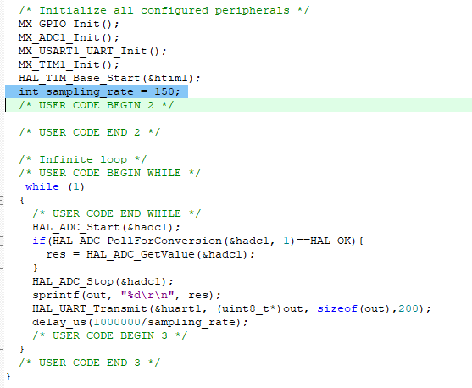
Code implementation
To set the sampling rate from the source code
The sampling rate is set by adjusting the delay_us to 1MHz / (the chosen sampling rate)

Slide 9
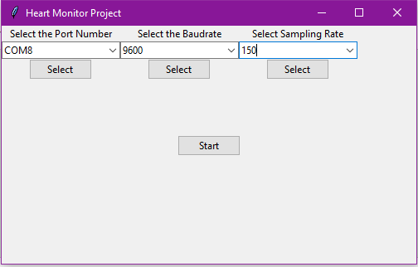
How to build and run the project
Firstly, the source code must be loaded on the microcontroller
Start main.py and select the desired values as shown below and click “Start”

Slide 10
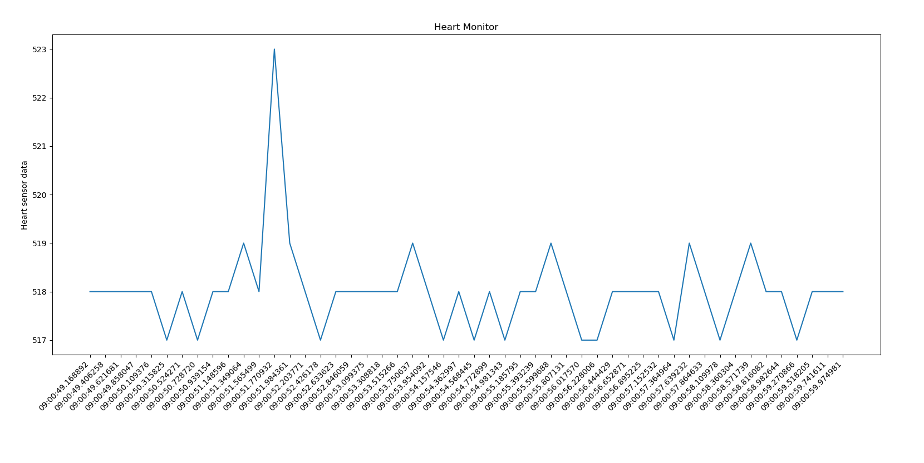
How to build and run the project
Firstly, the source code must be loaded on the microcontroller

Slide 11
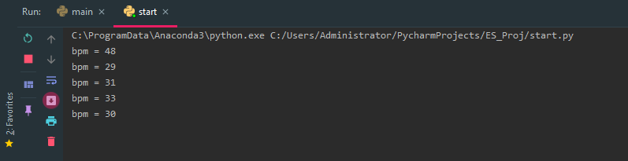
Bpm calculation
To calculate the bpm, “heartpy” lib is used to report the number pulses (spikes) per minute, but basically I calculate it every 15 seconds and multiply it by 4 and repeat the process every 15 seconds. (The below values are inaccurate since I have only 2 electrodes)

Slide 12
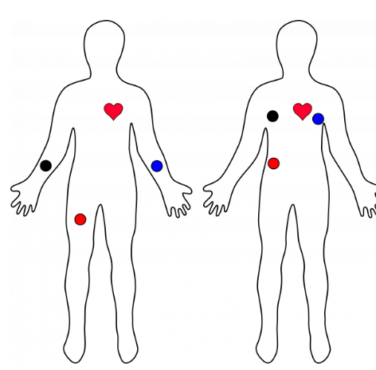
ECG Electrodes Placements & Expected Output
These are the typical ECG electrodes placements which provide efficient output.

Slide 13
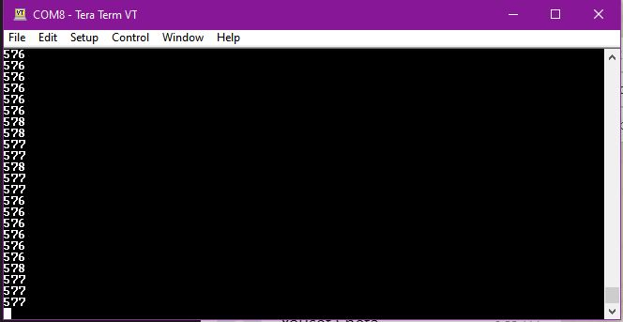
Results on Tera Term

Slide 14
Github Repo
https://github.com/AhmedAbouzaid1/Heart-Monitor

Slide 15
Thank you!

